Slide 1
POCKETSPHINX
AKUnited (RoboApp)

Slide 2
Why Pocketsphinx?
Pocketsphinx is a lightweight, mobile friendly speech recognition library developed by Carnegie Mellon
Can be used on PC, Max, Linux, iOS, and Android
It is easy to install and work with
Used to prevent the use of the GUI that the google speech API requires
http://cmusphinx.sourceforge.net/wiki/tutorialpocketsphinx
Notes:
link to webste
add supported devices
addd re=ource links
post on piazza

Slide 3
Installation
Installation is a simple process
Simply place jar and JNIlibs files, and compile them with your project
Create an assets folder and link it to your project
Assets include several different types of files
The .dict file is a file that includes a dictionary of words and their phonetic representation (ex: kitty K IH T IY)
The .gram file includes the words from the .dict file that the recognizer should search for in a grammatical search
In code, set up recognizers based on these files

Slide 4
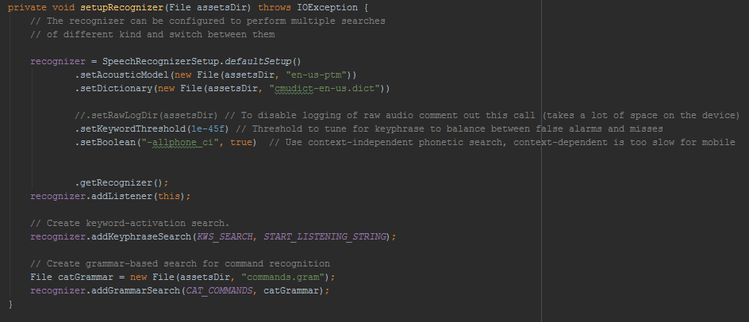
Notes:
bigger screenshot
add description

Slide 5
Types of searches
Pocketsphinx has several different search types that can be utilized
Grammatical search
Pocketsphinx listens and then searches through a list of words that you give it within a .gram file, in an effort to reduce errors.
Phonetic Search
Recognizes phenomes as opposed to words
Keyword search
Listens for a specific keyword before taking action (ex: “Okay rufus”)

Slide 6
Use
Once the search has finished, you can take the string that the listener heard and do with it as you please
In our case, we take the string and search for any other keywords that will activate commands.
This is now all done hands-free thanks to pocketsphinx
Notes:
scrreenshots of code

Slide 7
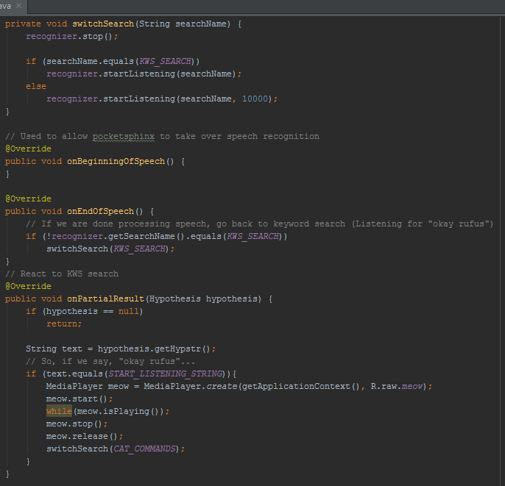
Use (cont.)

Slide 8
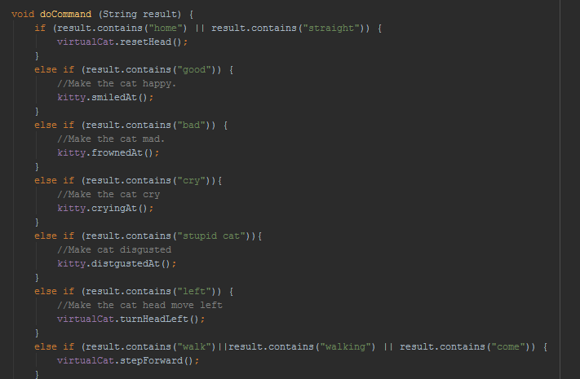
Use (cont.)

Slide 9
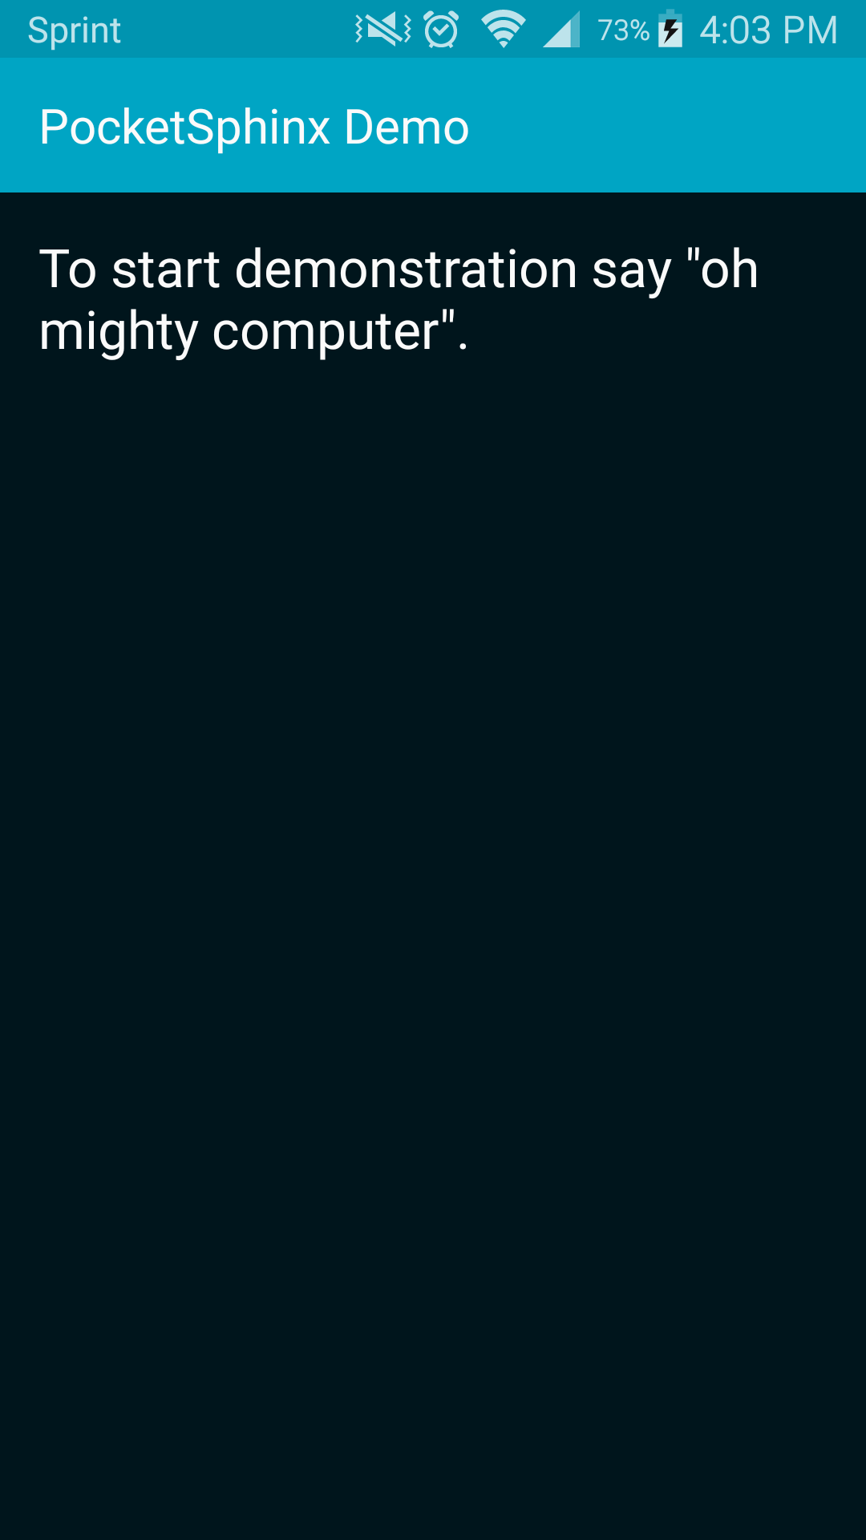
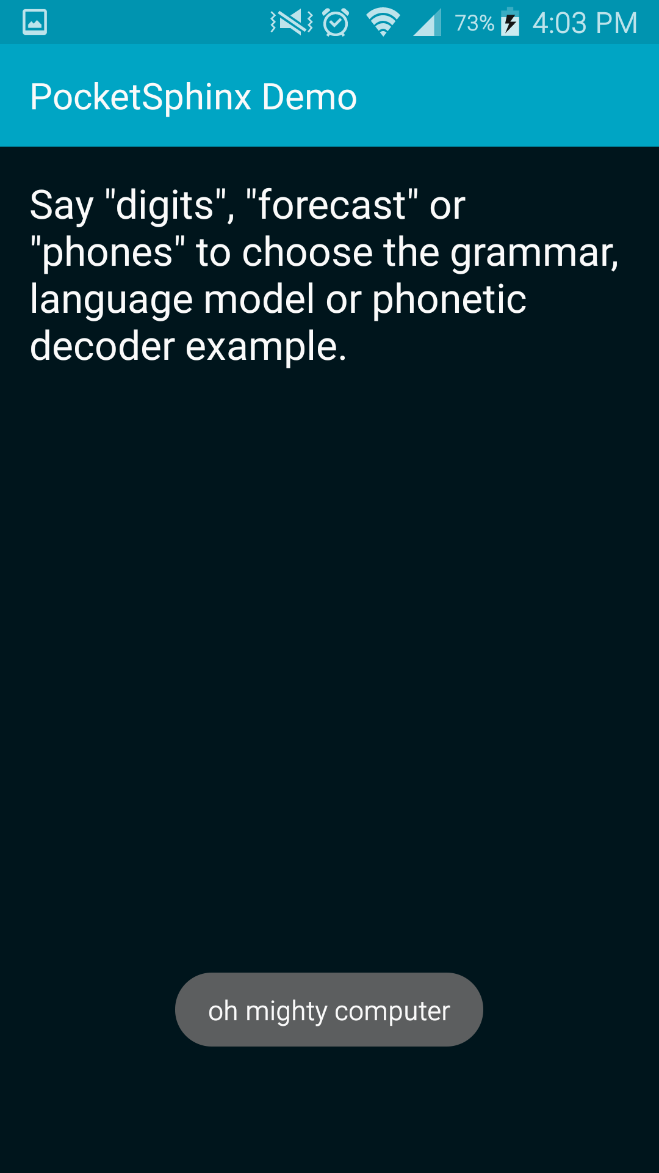
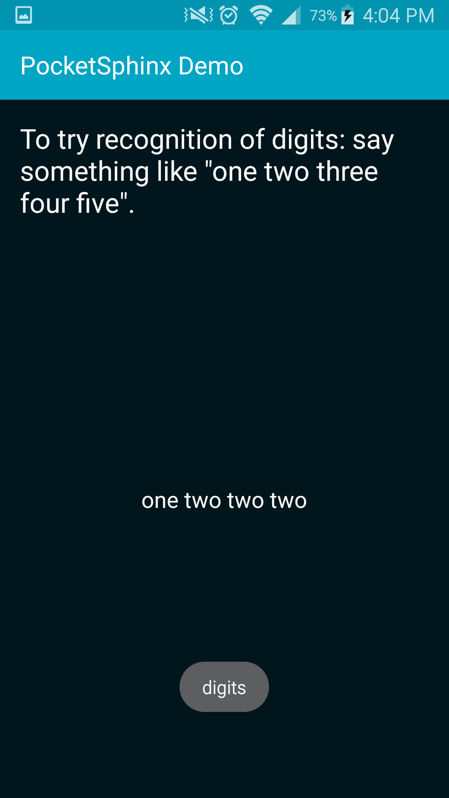
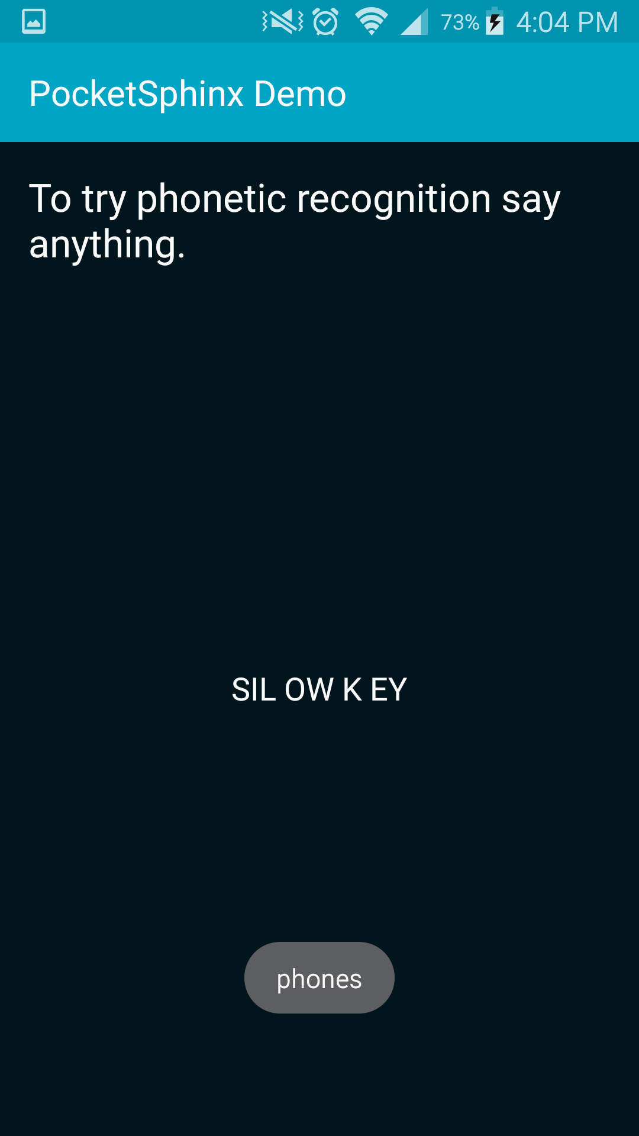
Demo

Slide 10
Problems
The listener is very touchy and does not allow for setting a noise gate on the device, meaning it picks up all and any sounds and will try to search for a word when no word was really said.
You can not get volume data from the library, only speech in a string

Slide 11
Concluding Thoughts
Pocketsphinx is very usable and allows for features that would otherwise be impossible or require loads of work
Installation is easy
Simple to start using the functions within
Gives data back in a very usable format
There are some problems, but they may be fixable via other libraries

Slide 12
Additional Resources
GitHub: https://github.com/cmusphinx/pocketsphinx
Sample Application/Tutorial: http://cmusphinx.sourceforge.net/wiki/tutorialpocketsphinx

Slide 13
Additional Resources
GitHub: https://github.com/cmusphinx/pocketsphinx
Sample Application/Tutorial: http://cmusphinx.sourceforge.net/wiki/tutorialpocketsphinx

